Slide 1

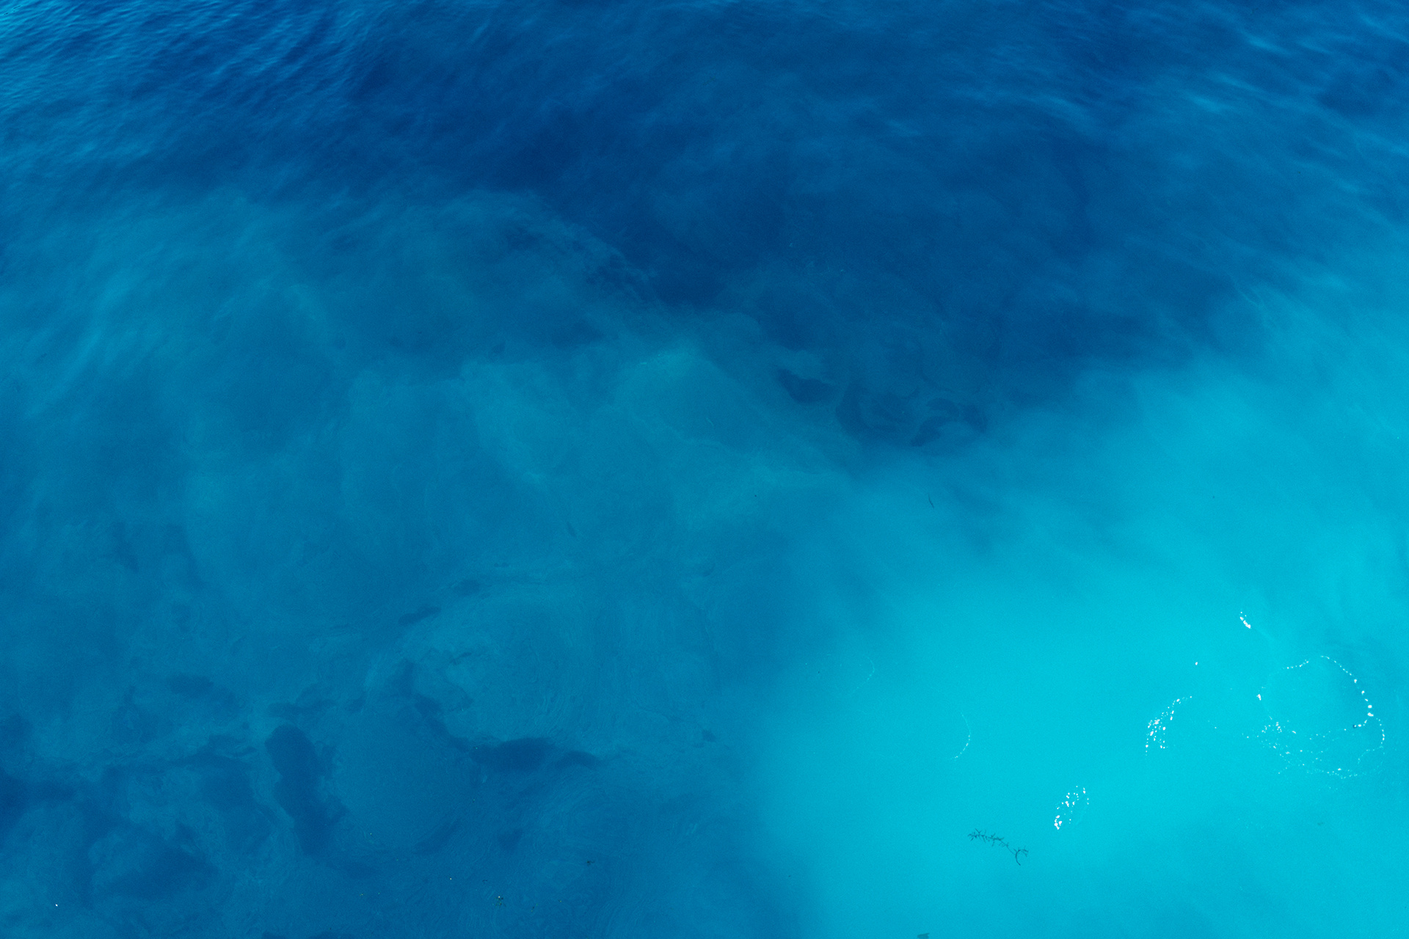

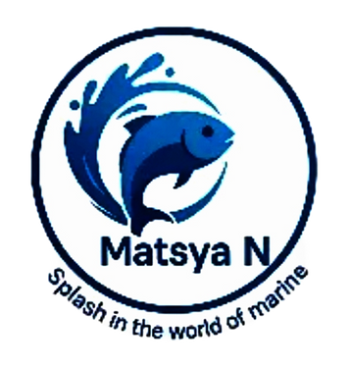
Agentic Hackathon
Team Name :
BrainChain
16.Create an app where fishermen
report plastic sightings or water
quality issues, crowdsourcing pollution
monitoring.
Problem
Statement :
Team
Members :
1.Nirmal P (Team Leader)
2.Paisal Ekbal A
3.Tamilselvi A
4.Udaya M

Slide 2
Introduction to solution:
We propose a smart floating marine device capable of detecting ghost fishing nets beneath the ocean surface.
Equipped with sensors like ToF laser, magnetometer, turbidity, pH, and pressure, the device monitors water parameters and identifies abnormal readings caused by underwater nets.
The data is transmitted wirelessly via an onboard antenna and visualized on a web dashboard with live location mapping, enabling real-time net detection near coastal areas.

Slide 3
Programming Languages
Libraries used:
C++ – For sensor coding on ESP32
HTML, CSS, JavaScript – For designing the web app
Sensor Libraries – VL53L0X, HMC5883L, etc.
Leaflet.js – To show live map
Chart.js (optional) – To display sensor data as charts
APIs & Communication
Tools Used :
ESP32 HTTP Client Library- sends data to thinkspeak
JSON-data format
WIFI(802.11)-network layer
Thinkspeak-cloud service for IOT
Wokwi – To simulate hardware online
GitHub – To manage and share code
Meshy.ai – To design 3D model of device

Slide 4
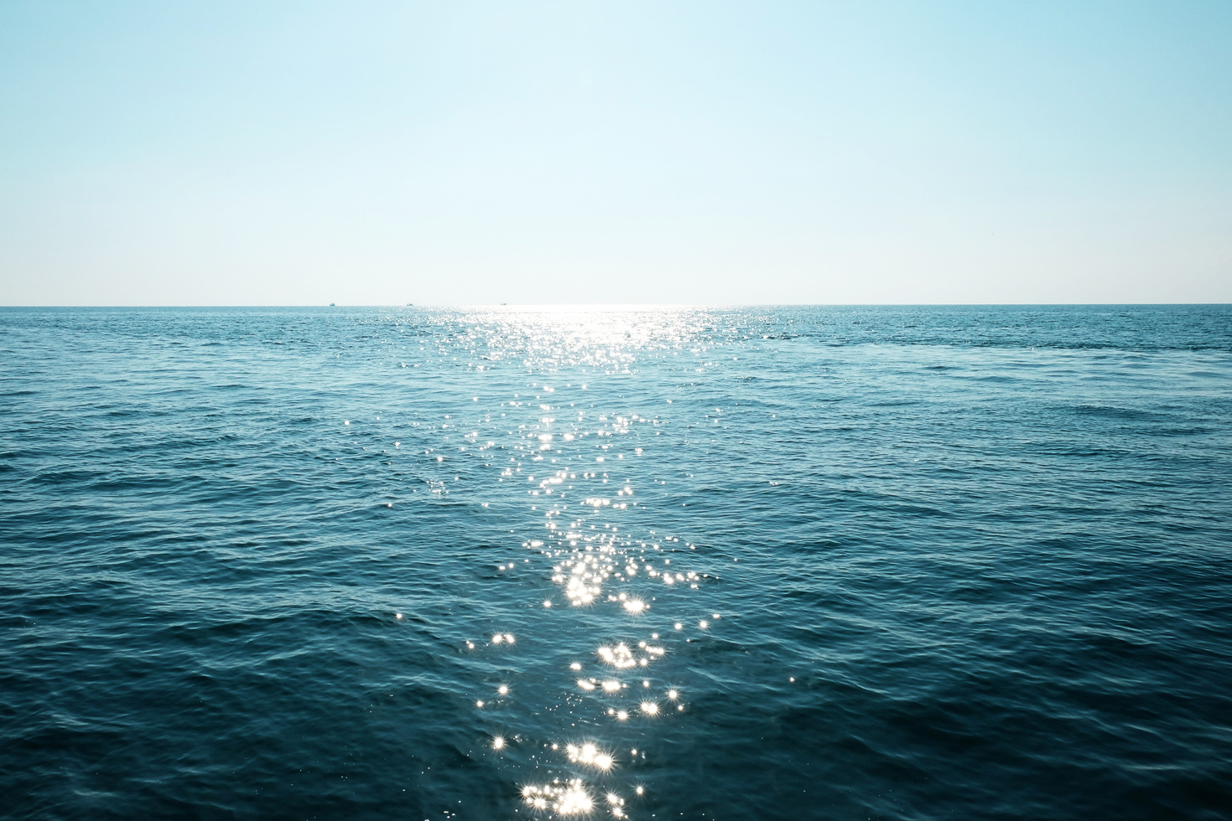
Our project aims to tackle ocean pollution caused by ghost nets using a smart floating device. It uses sensors to detect underwater threats and sends real-time data to a web dashboard.
This system helps monitor marine health, track ghost net locations, and alert coastal teams—making ocean protection smarter and faster.
Youtube video link:
https://youtu.be/efNZt9W_u58?si=fbjrqM-KzkpoW2bF

Slide 5
Business Analytics
🔍Use Case:
Detects ghost nets in water to reduce marine pollution and protect sea life.
Helps reduce marine pollution and protect aquatic life.
🌍 Market Impact:
Useful for coastal guards, fisheries, and environmental teams.
Helps clean oceans and supports sustainable fishing
📈 Scalability
Can be scaled to multiple devices floating in oceans, lakes, or rivers.
Data can be integrated into central monitoring systems.
Can add AI-powered detection in future for better accuracy.
Possible mobile app support for real-time alerts and updates.

Slide 6
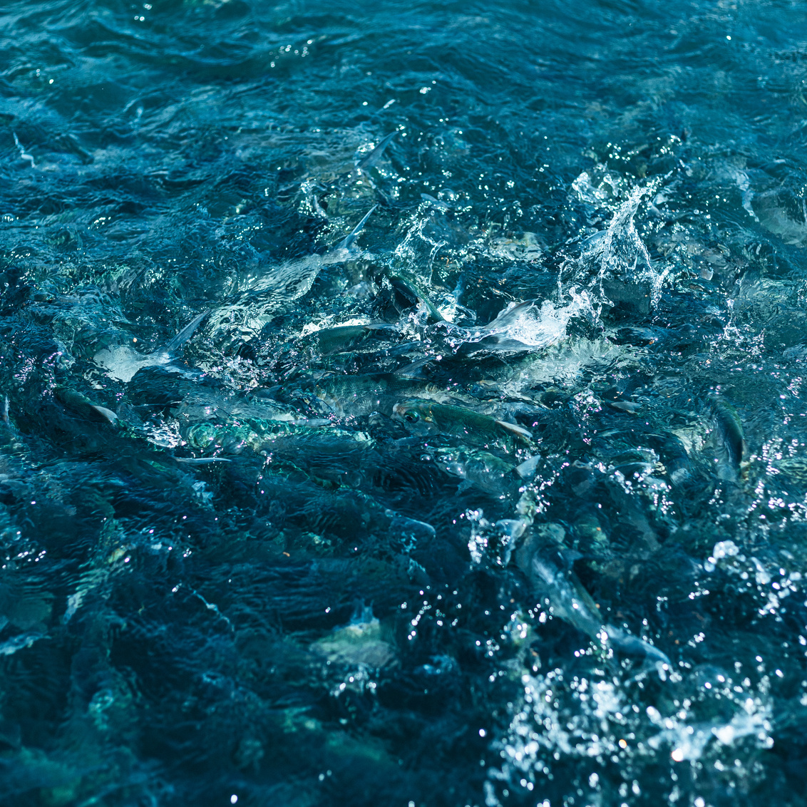
THANKYOU

